Slide 1


TriageAI
Your Intelligent First Step to the Right Care
Reducing $50B in Wasted Healthcare Spending from ER Misuse
John Smith, CEO | john@triageai.com | www.triageai.com

Slide 2


The Healthcare System is Broken at the Front Door
13-27%
of all ER visits are for
non-urgent conditions
,
resulting in billions in wasted costs and increased wait times
for true emergencies.
Fragmented system + patient anxiety
leads to delayed care,
worse outcomes, and medical debt, especially for the
uninsured and underinsured.
Current digital symptom checkers rely on generic advice and offer little actionable direction to appropriate care options.
The Human & Financial Cost
36%
41%
$50B+
of adults skip care due to cost
have medical debt
annual waste from ER misuse

Slide 3

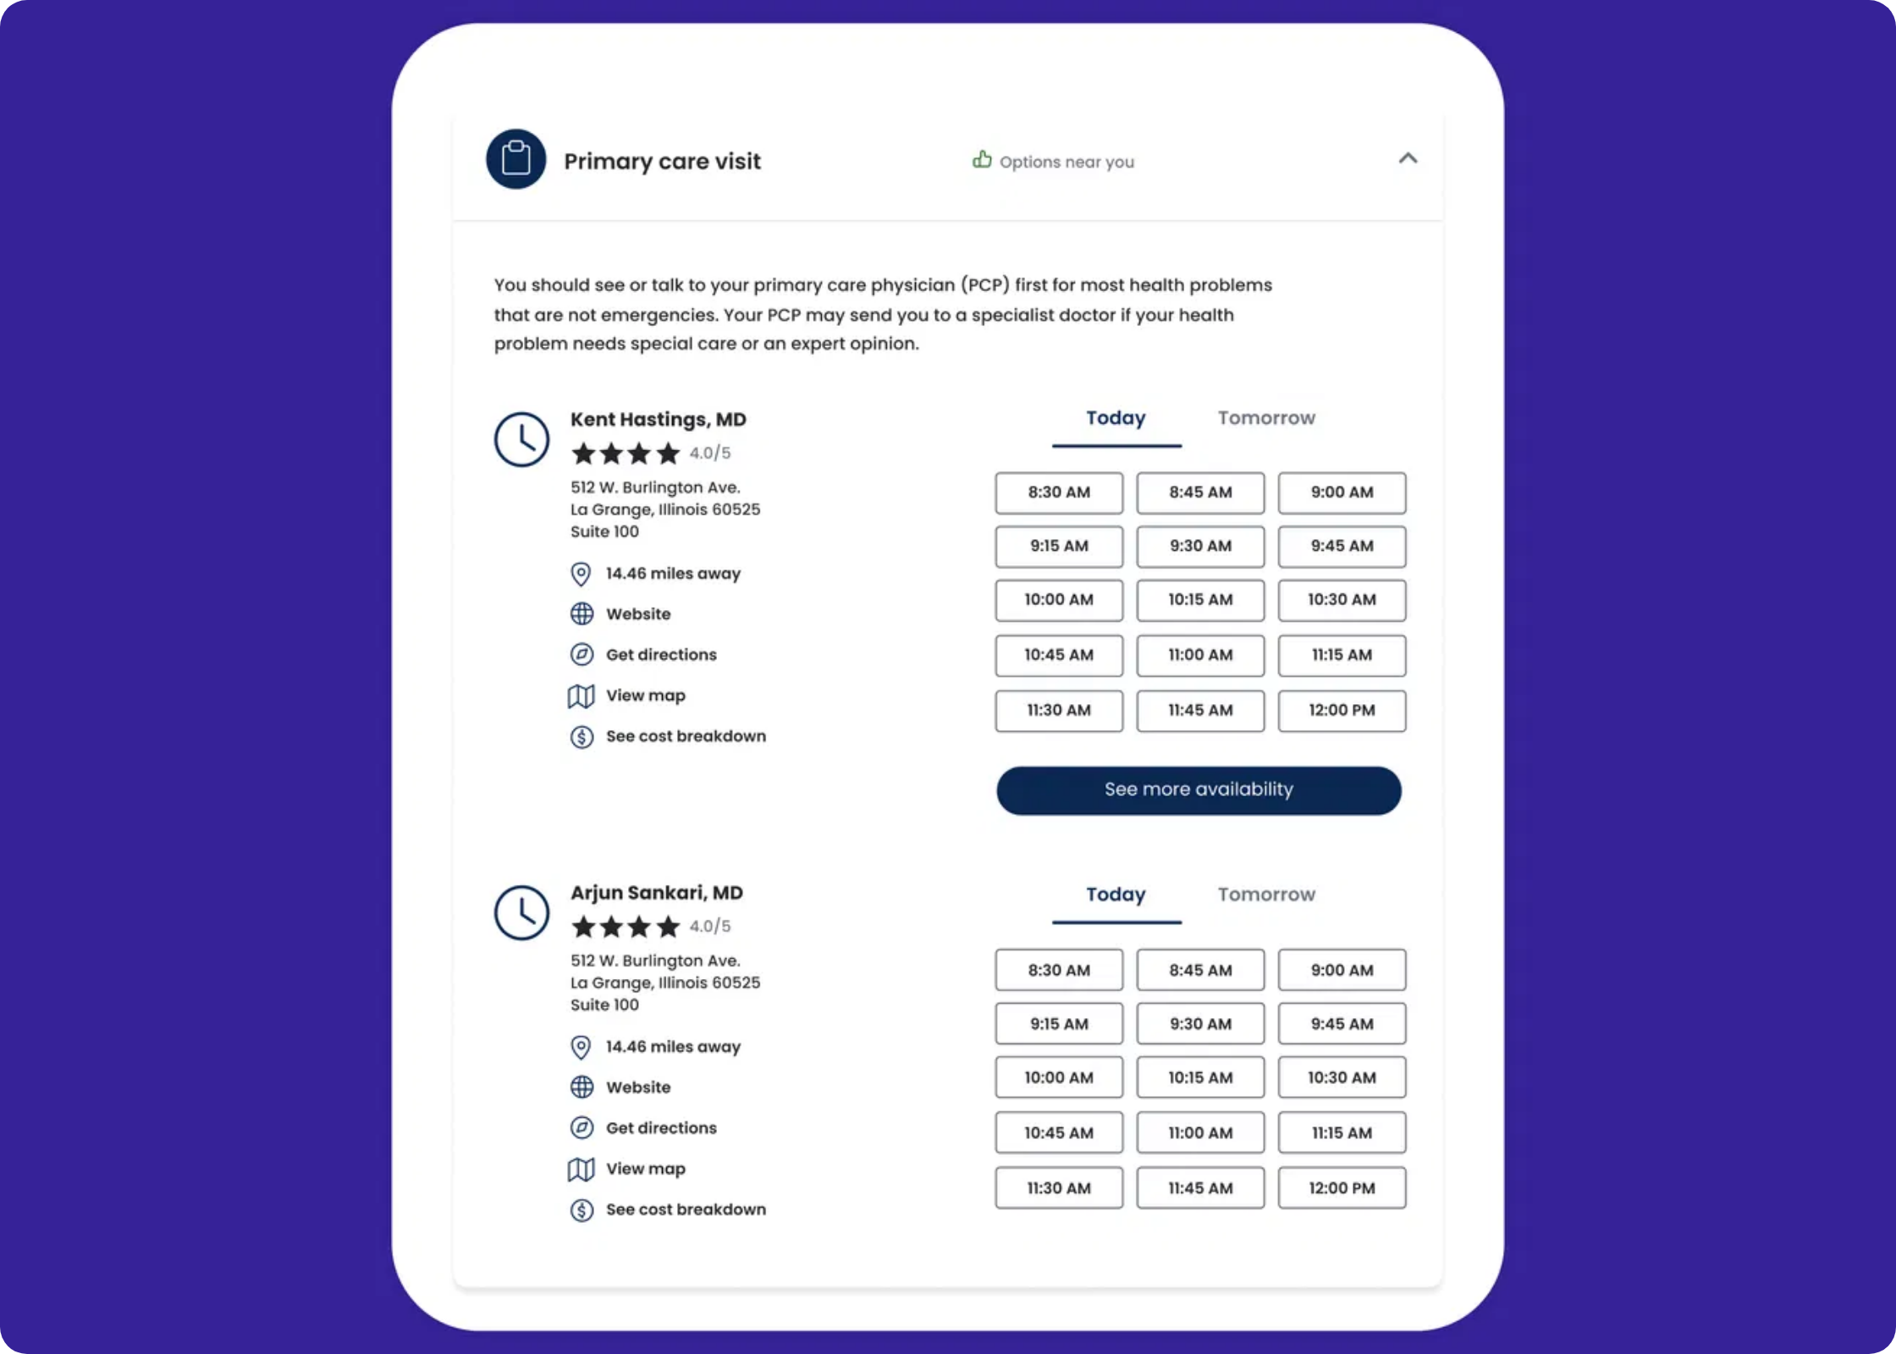
From Symptom to Solution in One Conversation
User describes symptoms
1
Text or image input of symptoms, with AI-guided follow-up questions for clarity
AI assesses urgency
2
Evidence-based triage into clear categories: Emergency, Urgent, Routine, or Self-Care
Matched to ideal care
3
Personalized care options based on urgency, location, insurance, and affordability
Multi-modal AI Triage:
Combines a fine-tuned Medical LLM
and Vision AI to analyze text + images
Evidence-Based Guidance:
Safe, conservative urgency
assessment following medical guidelines
Smart Resource Matching:
Finds the right care based on
multiple factors including affordability

Slide 4

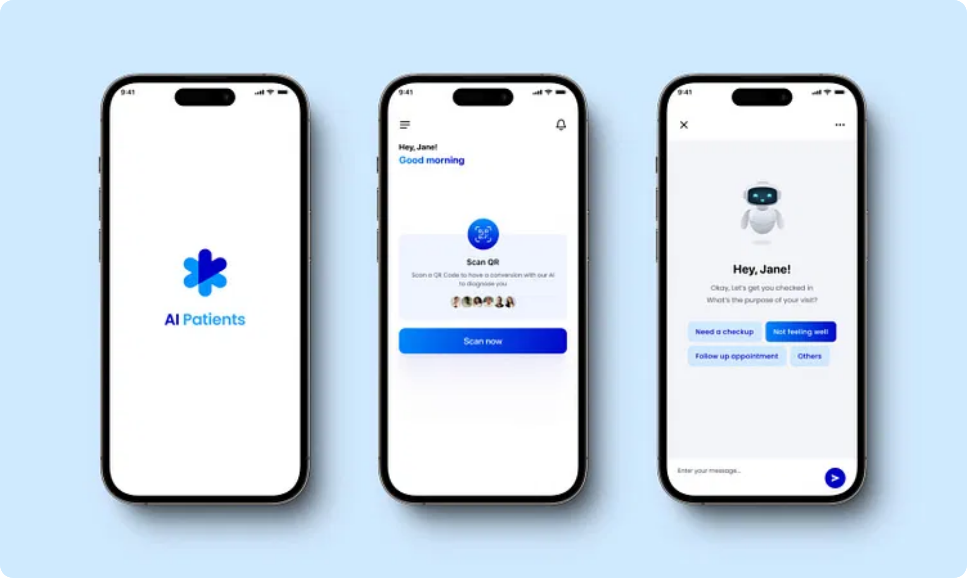










The Technology Behind Smarter Care Navigation
Input Layer
User → Text / Voice / Image Upload. Multi-modal interface captures symptoms
through natural language and visual inputs, with
conversational UI
for follow-
up questions.
AI Brain
Medical LLM
(Fine-tuned Llama) +
Vision Model
(Google Cloud
Vision/TensorFlow Lite). Proprietary medical knowledge graph and triage
algorithm trained on clinical guidelines.
Data Layer
Geolocation
+
Curated Provider Database
(Cost, Insurance, Hours). Real-time
data integration with wait times, insurance acceptance, and sliding scale
availability.
Output Layer
Triage Level
+
Personalized Care Options
(Map, Directions, Telehealth Link).
HIPAA-Compliant
data handling with
API-First
architecture for seamless
Actionable guidance with clear next steps and direct connections to
end-to-end encryption
integration
appropriate care.
Cross-Platform
support (iOS, Android,
Scalable Cloud
infrastructure with
Web)
auto-scaling
Key Differentiator:
Seamless integration of advanced AI with practical, real-world
FHIR-Compatible
for healthcare
Analytics Dashboard
for enterprise
healthcare data to deliver not just medical advice, but actionable, affordable care
system integration
customers
options.

Slide 5
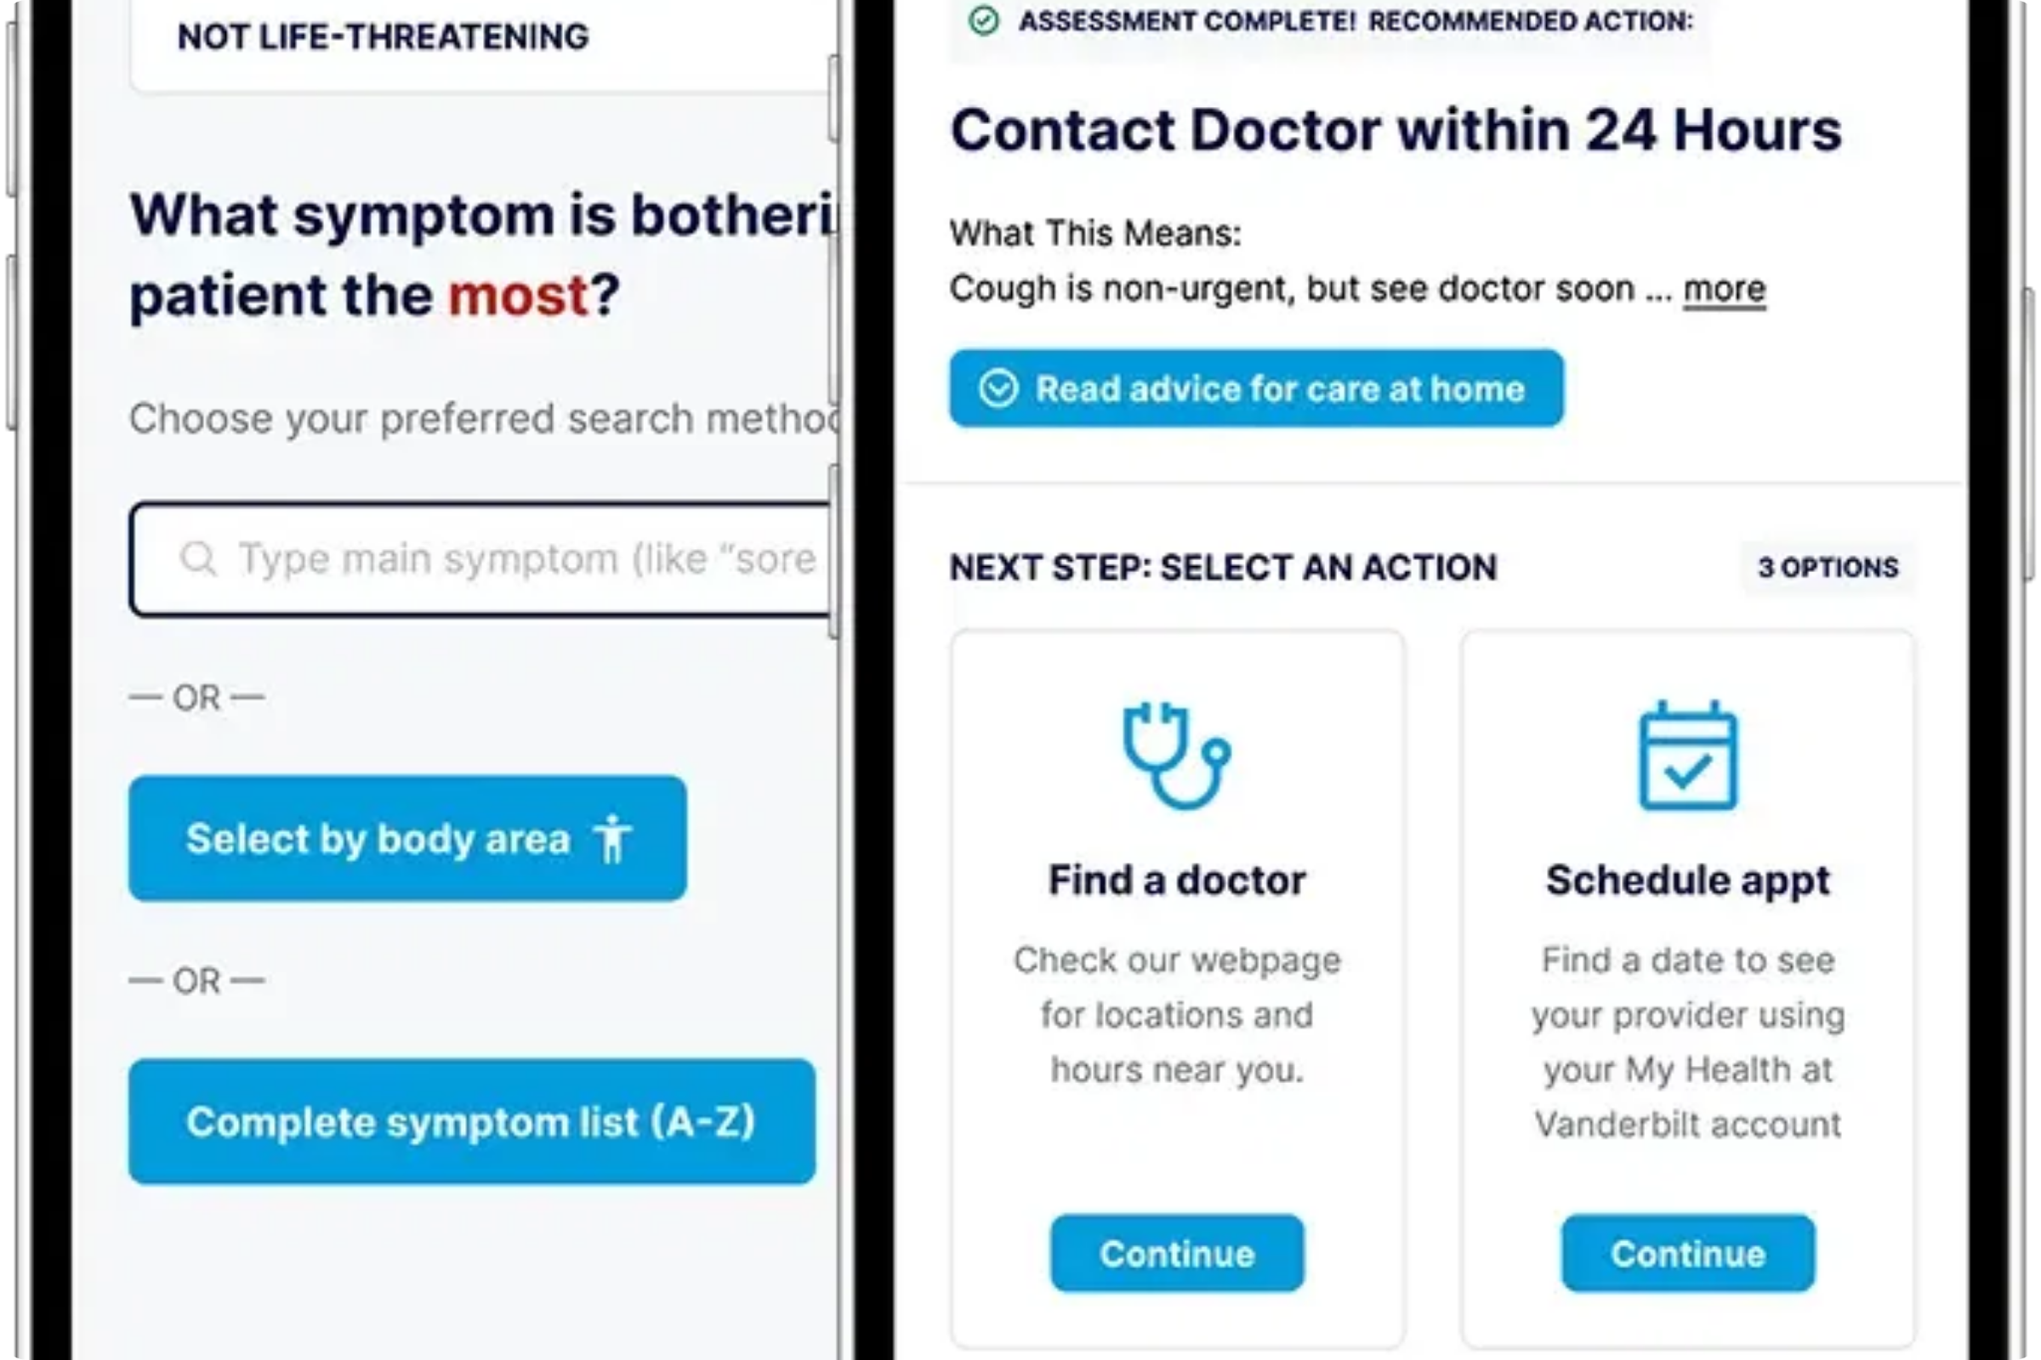
"Sharp abdominal pain + nausea" → Urgent Care in 0.7 miles
1
User describes symptoms
"I've been having sharp pain in my lower right abdomen since this morning. Also feeling nauseous."
2
AI asks clarifying questions
"How severe is the pain on a scale of 1-10? Have you had a fever? Does the pain worsen when you move?"
"Pain is about 7/10. No fever. Yes, hurts more when I move around."
3
Triage assessment
"Based on your symptoms, this should be evaluated soon."
Urgent
"Sharp lower right abdominal pain with movement sensitivity needs prompt medical
attention."
4
Personalized care options
"
1. City Urgent Care
- 0.7 miles | 15 min wait | Accepts insurance
2. Community Health Center
- 1.2 miles | Sliding scale payment
3. Virtual Urgent Care
- Available now | $49 flat fee"
"We don't just tell you
what
to do, we show you
how
and
where
to get the right care at the
right price."

Slide 6








From Concept to Validated Prototype
MVP Complete
>85% Accuracy
Full-stack demo with Flask backend, LLM integration, and React Native mobile interface. Ready for pilot deployment.
In triage-matching against established medical guidelines. Consistently outperforms generic symptom checkers in clinical validation.
SF Provider Database
Curated 100+ clinics with detailed affordability data, including urgent cares, free clinics, and ERs across San Francisco.
Clinician & Patient Validation
Positive feedback from healthcare providers and patients on usability, accuracy, and actionable guidance.
Pilot Partnerships
Roadmap Progress
In discussion with Bay Area student health organizations and local clinics for initial pilot deployment.
Concept
MVP
Pilot
Scale
"TriageAI provides what other symptom checkers don't - clear direction on where to go based on my specific situation and budget constraints."
— Patient Feedback, Early Testing Phase

Slide 7

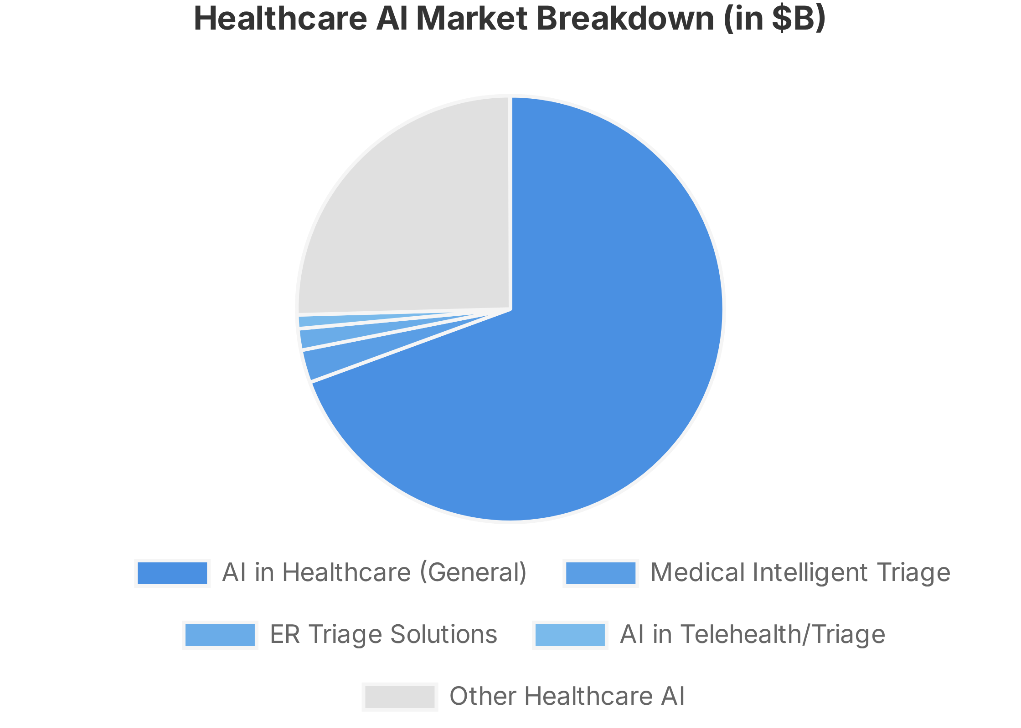
The $500B+ Market Opportunity
TriageAI is positioned at the intersection of rapidly growing markets in healthcare AI, triage systems, and telehealth solutions.
Global AI in Healthcare
$504B by 2032
From $39.25B in 2025
ER Triage Market
$8.22B by 2032
CAGR 10.8%
AI in Telehealth/Triage
$5.3B in 2025
CAGR 36.35%
Sources: Fortune Business Insights, Coherent Market Insights, LinkedIn Market Analysis, Towards Healthcare
Key Opportunity:
We are targeting the high-growth intersection of
AI, telehealth, and cost containment - driven by rising patient
volumes, ER overcrowding, payer cost pressures, and regulatory
incentives.

Slide 8
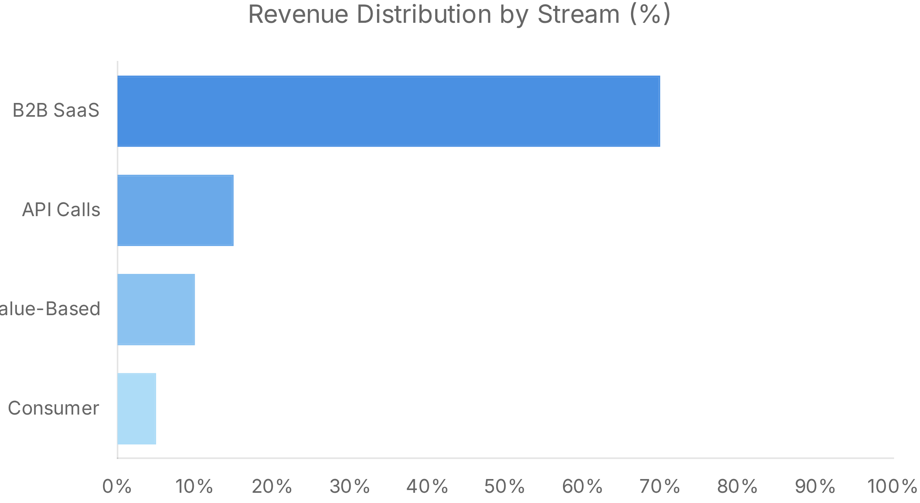




Monetizing the "Digital Front Door"
B2B SaaS License
White-label solution for hospitals, insurance plans, and clinics
$50,000 - $500,000+ per year
API Calls
Per-assessment charge for telehealth and wellness platforms
Volume-based pricing
Value-Based Pricing
For payers based on ER diversion and cost savings
% of demonstrated savings
Consumer Premium
Free basic app with premium navigation features
$4.99 - $9.99 per month
Multi-pronged approach targeting healthcare payers.
Similar AI triage startups
target annual contracts in the $50k–$500k+ range.

Slide 9

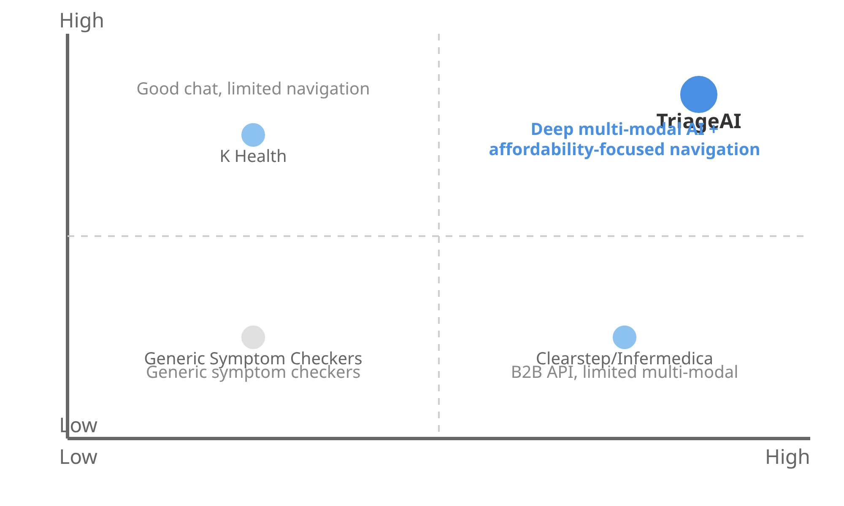



We Win on Affordability Navigation and Multi-Modal Input
Competitive Landscape
K Health
AI-driven chat for symptom checking with 3M+ users. Strong text-based AI but limited navigation to affordable care options.
Feature Sophistication (Text + Image)
Clearstep / Infermedica
B2B API solutions for health systems. Strong enterprise integration but limited multi-modal capabilities and minimal affordability focus.
Babylon Health
UK-based digital-first care platform. Limited US presence and minimal focus on cost-sensitive populations.
Aidoc
Focused on radiology triage rather than comprehensive patient navigation and intake.
Actionable Navigation (Cost/Access)
Our Key Differentiator
TriageAI is the only solution built from the ground up to solve for the underinsured and cost-burdened.
While competitors focus on general symptom
assessment, we combine sophisticated AI with affordable care navigation.

Slide 10

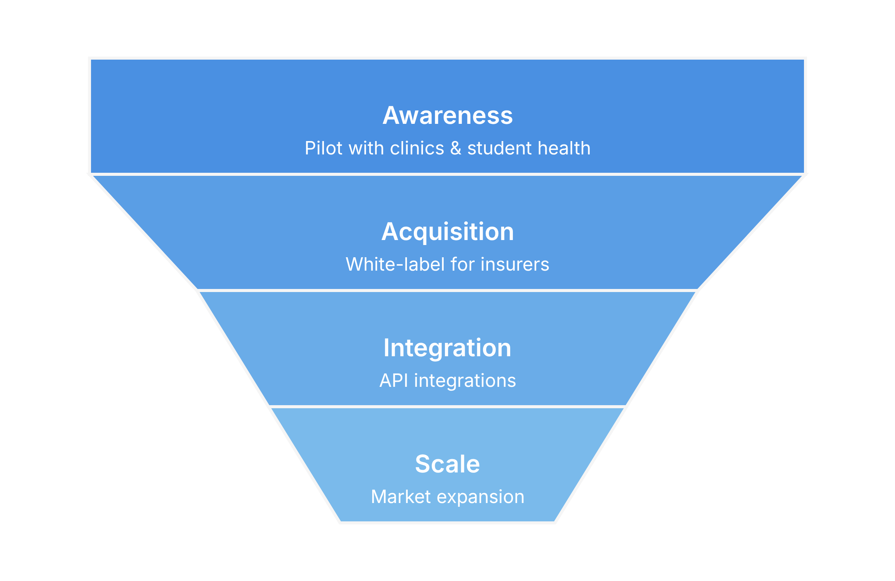


Partnering with Payers and Providers to Drive Adoption
Pilot & Validation
Launch with safety-net clinics and student health organizations to prove outcomes and gather real-world data.
Enterprise Expansion
White-label for insurers and self-insured employers, leveraging pilot data to demonstrate ROI.
API Integration
Develop API integrations with major telehealth platforms and EHR systems to scale distribution.
Key Strategy:
Use initial pilots to generate the outcomes data needed to land large
enterprise contracts, then leverage those relationships to drive API adoption and
scale.
6 months
12 months
18 months
24+ months

Slide 11











The Right Team to Solve a Complex Problem
Our leadership team combines decades of experience in AI/ML, healthcare operations, and scaling regulated technology startups.
Dr. Sarah Chen
Michael Rodriguez
Aisha Washington
CEO & Co-Founder
CTO & Co-Founder
COO
Former ER physician. Led digital health at Kaiser Permanente. MD from Stanford.
AI/ML expert with previous exits in healthcare tech. MS in CS from MIT.
15+ years scaling healthcare operations. Former VP at One Medical.
Dr. James Park
Elena Gomez
Robert Kim
Chief Medical Officer
Head of Privacy & Compliance
Head of Partnerships
Board-certified in Emergency Medicine and Clinical Informatics.
Former privacy counsel. Expert in HIPAA and healthcare regulations.
10+ years in healthcare business development. Previously at Zocdoc.
Advisory Board
Dr. Lisa Johnson
Thomas Wright
Prof. Maria Garcia
David Chang
Former CMO, Medicare
CEO, Regional Hospital Network
Director, Health Equity Research
Partner, Healthcare Ventures

Slide 12

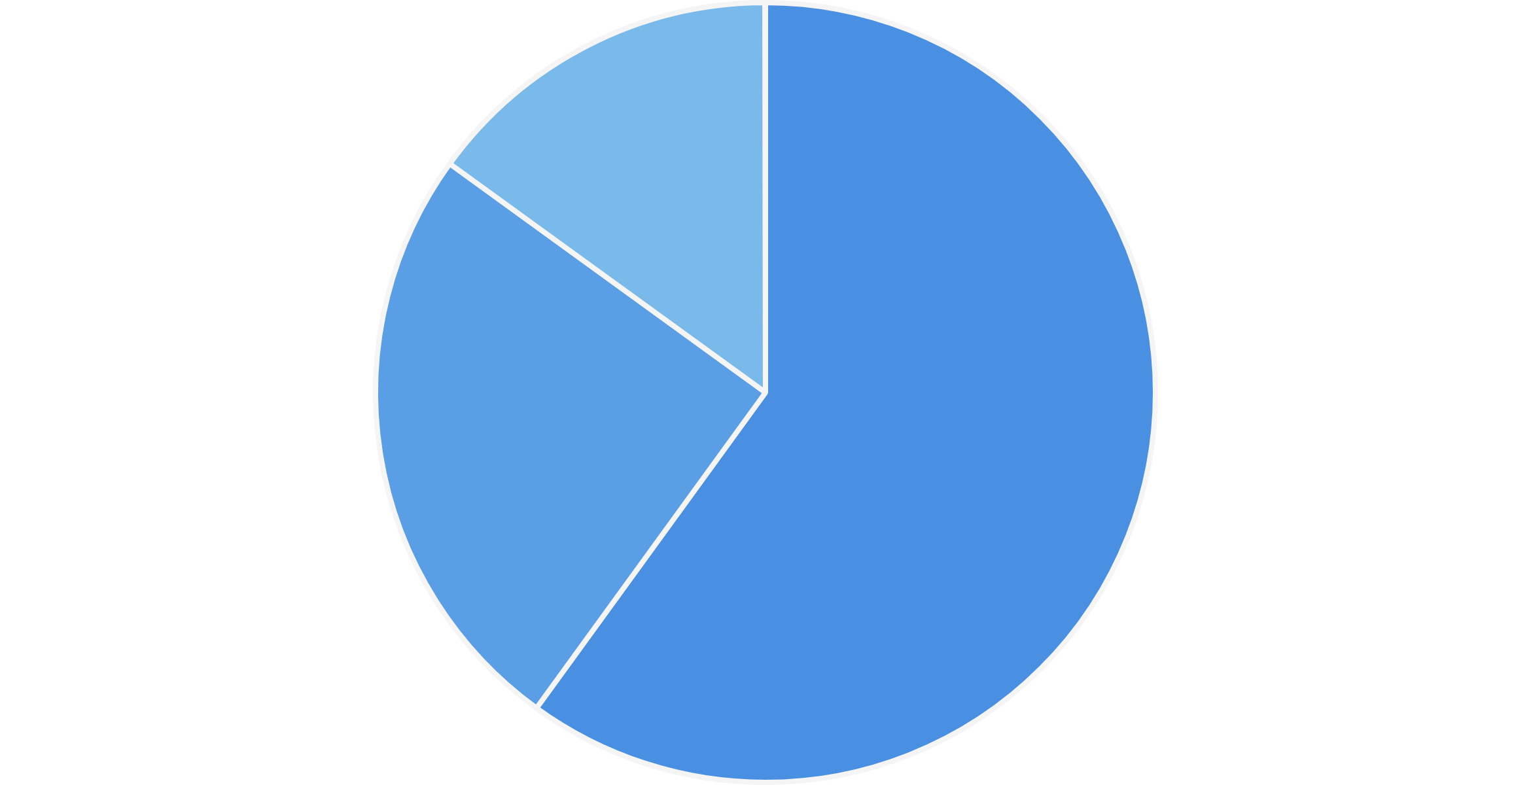




Seeking $3M to Launch Our Pilot and Secure Enterprise Partners
$3,000,000
Use of Funds
We're raising a seed round to accelerate our pilot launch, refine our AI models, and secure our first enterprise partnerships.
Key Milestones for the Round
Launch and complete pilot with 500+ users across multiple healthcare settings
Secure first 2-3 paid enterprise pilots with health systems or insurers
Achieve HIPAA compliance and develop FHIR/EHR integration specifications
Expand provider database to 3 major metropolitan areas
Product: Engineering & AI Model Refinement (60%)
Demonstrate 30%+ improvement in appropriate care utilization
Go-to-Market: Sales, Pilots, Partnerships (25%)
Operations & Admin (15%)
18-Month Runway
Months 1-6:
Pilot launch, technical refinement, initial partnerships
Dr. Sarah Chen, CEO
| sarah@triageai.com | www.triageai.com
Months 7-12:
First paid enterprise pilots, expansion to new markets
Months 13-18:
Series A preparation with demonstrated outcomes data

